Slide 1
Chapter 2
Income

Slide 2
Income vs. Development (Don’t confuse these!)
Economic development involves many outcomes:
  Income growth (Chs 2 & 6), poverty (3), inequality (4), human welfare (5)
One theme of this class:
  Income growth and development are different things
  …but it’s hard to have development without growth

Slide 3
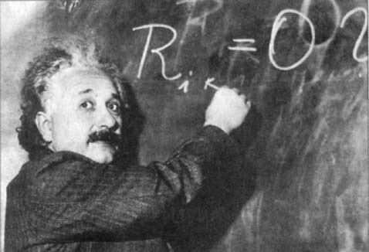
Tools of the Trade:

Slide 4
What is Growth? Income?
Growth: Rise in national or per-capita income and production (Ch. 6)
Gross National Product (GNP; same as Gross National Income)
  Add up value of all final goods and services produced in a country then sold
    Value at market prices
  Alternatively, add up the cost of all factor inputs (Capital, Labor, Land), called Value Added.
    GDP at factor cost

Slide 5
What’s NOT in GDP?
GDP Excludes intermediate inputs (no double counting)
Includes goods & services produced by citizens abroad (Mexican migrant remittances add ~$25 billion/year to Mexico’s GNP!)
Excludes goods & services not sold
    Get divorced, hire a cook or nanny, and GNP goes up!
    Same if subsistence farm sells instead of eating its rice
    Me and Home Depot = no contractor and lower GNP
What about obesity? The environment?

Slide 6
Per-capita Income
Take the GNP
Divide by the population
What everyone would have if income were perfectly equally distributed
One measure of welfare (and development)

Slide 7
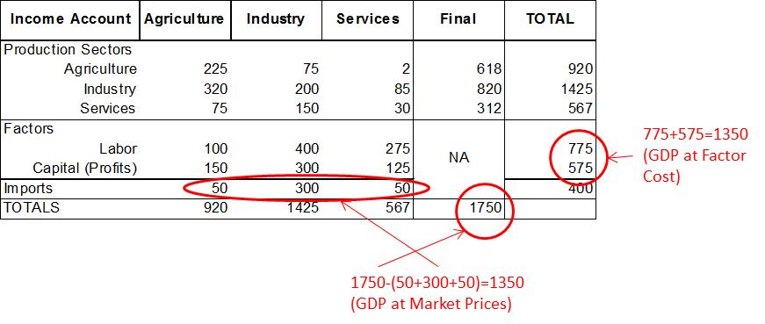
Input-Output Accounting

Slide 8
Green Accounting
697.5+517.5=1,215

Slide 9
GNP vs. GDP
Gross Domestic Product: Like GNP but only counts income earned within a country’s borders
  Philippines: GDP is ~6% lower than GNP, because it doesn’t count income of Philippin migrants working abroad
  If Philippine person works in Malaysia, the value of output she produces counts in the Philippines’ GNP but not its GDP.
    It counts in Malaysia’s GDP but not GNP
We often use GDP; it usually doesn’t matter much

Slide 10
Real vs. Nominal GDP
Real means “adjusted for inflation”
  Very important for comparing a country’s changes in income over time:

Slide 11
Purchasing Power Parity (PPP)
Adjusts exchange rates for purchasing power of income in different countries
  Critical for comparing incomes across countries
    Mexico: Exchange Rate on 1-5-2010 was 12.8 pesos/US$
    But you get more for your money in Mexico (~44% more), so the PPP exchange rate is around 8.9 (=12.8/1.44)
      In other words,12.8 pesos gives you not $1 but $1.44 (=12.8/8.9) in purchasing power in Mexico if you adjust for PPP!

Slide 12
Making an Income Index
Rank index:
Income index (see index generator program):

Slide 13
Country Typologies
World Bank Standard:
  Low Income (<US$765/capita in 2003)
  Lower Middle ($765-$3,035)
  Upper Middle ($3,035-$9,385)
  High (>$9,385)
Other terms:
  Third World (Pretty much out of use)
  Less Developed, Developing (Commonly heard at international forums)
  Emerging (Rapidly growing: China, E. European)
  Industrialized (What about post-industrial OECD?)
  Transitional (E. Europe, Russia, Ukraine: Controlled market -> market oriented economies)
  North-South (Imprecise, but still heard sometimes)

Slide 14
Next Three Chapters
In 2010, just under 1.3 billion people—22.4% of the world’s population—lived on less than $1.25 a day (PPP adjusted).
The low-income countries contained 12.5% of the world’s population but controlled less than 1% of its income, while the high income countries had a little over 16% of its population and 72% of its income.
In the poorest 10% of countries, those with GDP per capita less than $1,123, life expectancy averaged 54.4 years (compared to 80 in the richest 10%), and years of schooling averaged 3.2 years (compared to 10.5 years).

